Slide 1
First steps in health and social care research seminar
Research Design Service East Midlands March 2022

Slide 2
Building a good research question and team
Dr Shaun Barber
Quantitative Adviser RDS East Midlands

Slide 3
Background
How bad is problem?
What don’t we don’t about this area?

Slide 4
Idea
How would this work help?
What is the size of the change?
Who is calling for this work

Slide 5
Research question
Make it short
Keep it simple
Check it with public contributors, social care practitioners, clinicians etc and reviewers

Slide 6
PICO: Quantitative
Population
Intervention
Comparison
Outcome

Slide 7
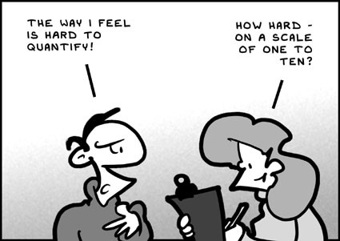
PICO: Qualitative
Population
Interest
Context

Slide 8
What about aim, objectives and title?
Aim: best to go for single aim
Objectives: break down aim into major milestones
Title : descriptive and concise

Slide 9
Team
Principal investigator
Social care and/or clinical expert(s)
Statistician
Health economist
Public involvement lead
Health psychologist
Organisational psychologist
Qualitative expert(s)
Clinical trials Methodologist
Other specialist methodologists

Slide 10
Where to find team members
Statistician or Health economist:
CTU
your/collaborating university departments
consultancy unit
Health psychologist:
own department or organisation
some regional groups within British Psychology Society division of heath Psychology
European Health Psychology Society
psychology department in your university
Qualitative expert(s)
own department or organisation
speak to RDS about different types of qualitative experts

Slide 11
Useful links
SSCR NIHR: https://www.sscr.nihr.ac.uk/projects/research-priorities/
James Lind Alliance: https://www.jla.nihr.ac.uk/priority-setting-partnerships/adult-social-work/top-10-priorities.htm
NICE guidance: https://www.nice.org.uk/guidance/health-and-social-care-delivery
NIHR themed calls: https://www.nihr.ac.uk/documents/themed-call-complex-health-and-care-needs-in-older-people/24074
ENRICH NIHR: https://enrich.nihr.ac.uk/

Slide 12
Public Involvement (PPI) in Research
Dr Naina Patel PPI Lead

Slide 13
Outline
Part 1: The why, who, where and when in relation to public involvement
Part 2: Guidance and resources
Part 3: How can the Research Design Service East Midlands assist?

Slide 14
Part 1: The why, who, where, and when of public involvement

Slide 15
Why: NIHR requirement for public involvement
Involving patients, service users and the public in the design of the research is critical.
Public involvement must be routinely involved in the design of clinical and social care research, to ensure outcomes match their needs and studies are designed with real participants and the realities of their daily lives in mind.
Patients, the public and service users can provide insights from their lived experience and alternative views to those of research teams or NHS staff.
https://www.nihr.ac.uk/documents/briefing-notes-for-researchers-public-involvement-in-nhs-health-and-social-care-research/27371
https://www.gov.uk/government/publications/the-future-of-uk-clinical-research-delivery/saving-and-improving-lives-the-future-of-uk-clinical-research-delivery

Slide 16
Who is the public?
The term public involvement includes patients, potential patients, carers and people who use health and social care services as well as people from specific communities and from organisations that represent people who use services such as charities and support groups. Also included are people with lived experience of one or more health conditions, whether they’re current patients or not.

Slide 17
Equality, diversity and inclusion (1)
“A diverse and inclusive public involvement community is essential if research is to be relevant to population needs and provides better health outcomes for all.” (Going the Extra Mile, NIHR 2015)

Slide 18
Equality, diversity and inclusion (2)
Equality vs. equity:
“Equity is not about treating everyone the same; it is about ensuring that access to opportunities are available to all by taking account of people’s differing needs and capabilities” (Humber Teaching NHS Foundation Trust, no date)
Diversity:
“respecting and valuing all forms of difference in individuals” (INVOLVE 2012)
Inclusion:
“positively striving to meet the needs of different people and taking deliberate action to create environments where everyone feels respected and able to achieve their full potential” (INVOLVE 2012)

Slide 19
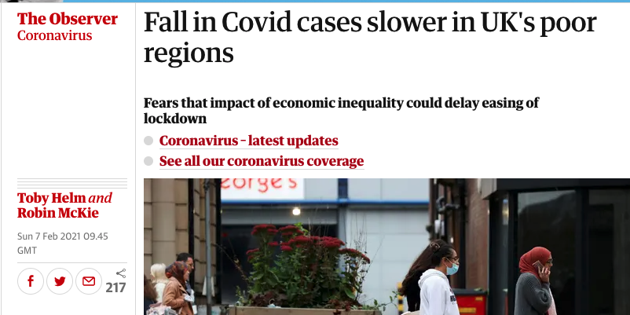
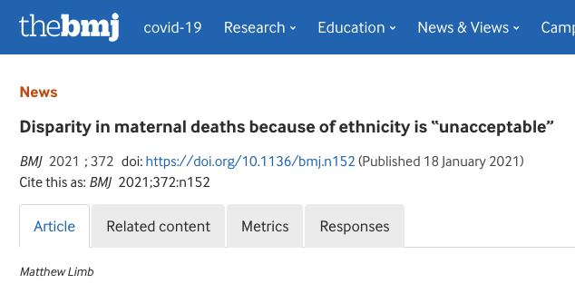
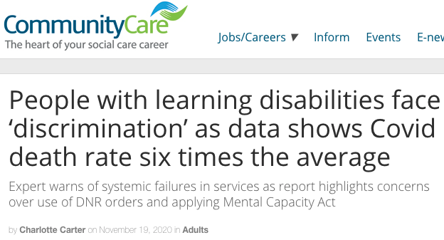

Slide 20
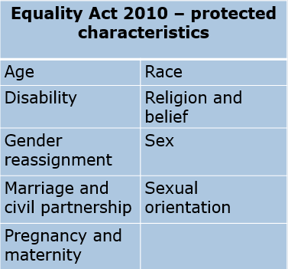
EDI in public involvement and research
And beyond…
Social class
Caring responsibilities
Neurodiversity
Literacy
Disadvantaged populations e.g. prisoners, homeless people
Geography

Slide 21
Where is public involvement positioned in research?
PPI Advisory Group with the Research Team Research
https://oxfordbrc.nihr.ac.uk/ppi/
https://www.towerfast.com/press-room/the-future-of-wearable-medical-devices
https://www.einfochips.com/blog/how-artificial-intelligence-is-transforming-the-healthcare-sector/

Slide 22
When do patients, public and service users get involved?
Identify research question
Influence clinical practice
Write & submit funding app.
The Research Cycle
Publicise research outcomes
Design study, get approvals
Analyse research outcomes
Carry out research study

Slide 23
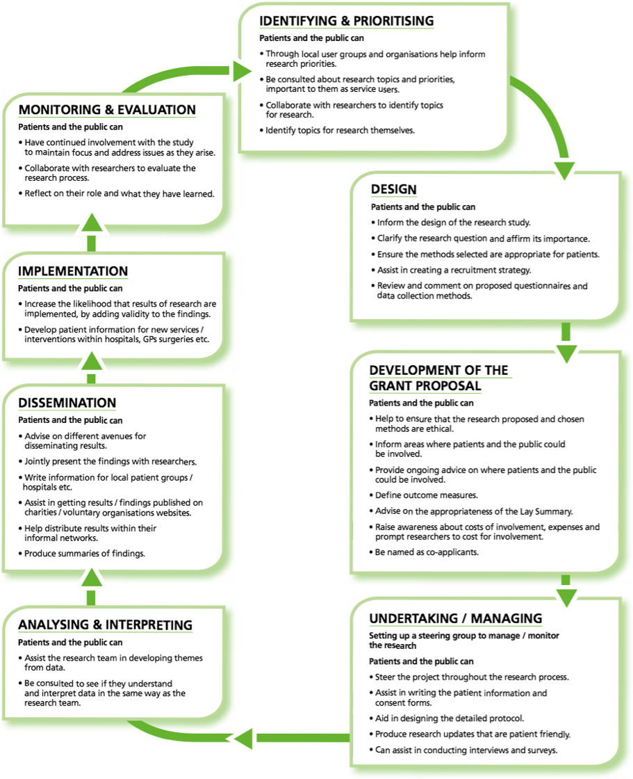
Health Expectations, Volume: 22, Issue: 4, Pages: 785-801, First published: 22 April 2019, DOI:(10.1111/hex.12888)

Slide 24
Part 2: Guidance and resources

Slide 25
Guidance and resources (1)
Start early with your public involvement!
For equality, diversity and inclusion guidance and resources: https://www.trialforge.org/trial-forge-centre/include/
Research Design Service for equality, diversity and inclusion toolkit: https://www.rdsresources.org.uk/edi-toolkit
Use the NIHR Payment for guidance for researchers and professionals to ensure you support your public contributors for their involvement and allocate a budget in your funding application. https://www.nihr.ac.uk/documents/payment-guidance-for-researchers-and-professionals/27392
Ensure the pubic involvement budget in your funding application adequately reflects the level and depth of public involvement you are going to undertake

Slide 26
Guidance and resources (2)
Public Co-applicant: no formal requirement but refer to NIHR guidance for https://www.invo.org.uk/posttypepublication/public-co-applicants-in-research-guidance-on-roles-and-responsibilities/
For more guidance on issues related to the involvement of a co-applicant refer to the following:
https://peterbates.org.uk/wp-content/uploads/2017/04/how_to_engage_people_as_research_co-applicants.pdf
PPI Lead: This can be someone within the research team who takes responsibility for co-ordinating meetings and supporting public involvement

Slide 27
Guidance and resources (3)
The standards are:
A framework for what good public involvement in research looks like
Designed to encourage reflection and learning
A tool to identify what is going well and what needs improving
Intended to be used with any method or approach to public involvement in research
https://sites.google.com/nihr.ac.uk/pi-standards/home

Slide 28
Part 3: How can the RDSEM assist with public involvement?

Slide 29
RDS East Midlands: Public involvement support and resources (1)
Patient and Public Regional Lead for PPI can assist with:
Advice and guidance on public involvement at the development stage of funding applications to individual researchers and in MAP meetings
Guidance on how to integrate public involvement in research projects
Guidance on budgeting for public involvement
How to ensure equality, diversity and inclusion in public involvement recruitment and research is integrated from the outset

Slide 30
RDS East Midlands: Public contributors (2)
We have an experienced and diverse team of public contributors that can:
Review plans for public involvement in funding applications for public involvement content and Plain English Summary
Review public involvement plans in practice Fellowship interviews
Take part in public involvement Advisory groups for researchers (upon request to PPI Lead)
Act as Co-applicants (upon request to PPI Lead)

Slide 31
Public Involvement Fund (PIF)
We provide small awards to support public involvement at an early stage in the development of funding application forms. The awards are as follows:
Type of funding application | Online/ Face to face pubic involvement activities | Amount allocated | Payment per public contributor
Team application | Online | £200 | £20
Team application | Face to face | £300 | £20 + expenses
Fellowship | Online | £100 | £20
Fellowship | Face to face | £150 | £20 + expenses

Slide 32
Introduction to NIHR Funding Programmes
Dr Brian Crosbie
Qualitative Adviser RDS East Midlands

Slide 33
NIHR Core Funding Programmes:
Health and Social Care Delivery Research - HSDR
The evaluation of innovations in health and social care organisation and delivery to improve service quality, efficiency, experience and access.
Research for Patient Benefit - RfPB
Lower cost research studies (qualitative, quantitative and mixed) to assess whether new interventions provide benefit for people with health and social care needs.
Research for Social Care- RfSC
Fund topics and research methodologies that increase the effectiveness of social care services, to benefit service users and carers.

Slide 34
Health and Social Care Delivery Research
Aim: To produce evidence to improve the quality, accessibility and organisation of health and social care services.
The evaluation of innovations in health and social care organisation and delivery to improve service quality, efficiency, experience and access
The goal is to produce evidence for managers, commissioners, clinical leaders and service users
Research should lead to changes in practice and organisation of NHS/social care
Studies should be carried out across more than one site
Encourage early careers research with strong mentoring
Funding: Commissioned and researcher-led, no fixed limits on duration or funding

Slide 35
HSDR examples:
Engaging general practitioners in service development and quality improvement in care homes: a realist synthesis of the published evidence
How best to deliver Comprehensive Geriatric Assessment in a cost-effective way
Accessibility and implementation in UK services of an effective depression relapse prevention programme: mindfulness based cognitive therapy
Impact of closing Emergency Departments in England (closED)

Slide 36
Research for Patient Benefit
Aim: Supports health, public health and social care research
Funding stream addresses a wide range of health challenges
Encourages early career researchers with strong mentorship
Lower cost research studies (qualitative, quantitative and mixed) to assess whether new interventions provide benefit for people with health and social care needs.
New annual Research for Social Care (RfSC) competition with no formal tiers, assessed by a national panel of social care experts and practitioners
Funding: 3 levels of funding in researcher-led calls:
Up to £350,000 over a period of up to 36 months
Feasibility studies up to £250,000
Up to £150,000 for higher risk projects- exploratory & development
Process: Two-stage process to one of the 10 regional funding panels, 3 calls per year

Slide 37
RfPB examples:
Co-production of best practice recommendations for local authority reviews of double-handed homecare packages
ORCHARD study: a realist review of hearing communication strategies for residents with dementia living in care homes
Preventing psychosis in young people at ultra-high-risk attending NHS mental health services: a feasibility study of a novel intervention target
A multicentre randomised controlled trial (RCT) of a self-help cognitive behavioural therapy (CBT) intervention to reduce the impact of hot flush and night sweat (HFNS) symptoms in men with prostate cancer undergoing androgen deprivation therapy

Slide 38
Research for Social Care
Aim: To fund topics and research methodologies that increase the effectiveness of adult social care services, to benefit service users and carers.
RfSC funds research which generates evidence to improve, expand and strengthen the way adult social care is delivered
Teams consisting of social care researchers, professionals/practitioners, carers and service users. With links to adult social care organisations/providers
Develop and evaluate new ways of delivering social care
Develop novel methodologies for adult social care research.
Funding: Currently, 1 call a year opens September:
Up to £350,000 over a period of up to 36 months
Two-stage process, through national committee

Slide 39
RfSC examples:
The effectiveness of the SIDECAR (scales measuring impact of dementia on carers) tool in improving carer quality of life in social care settings
Co-designing a toolkit of approaches and resources for end-of-life care planning with people with learning disabilities within social care settings
Promoting a social and rights-based approach to assessment under the Mental Health Act
Together in Prison: Developing a parenting programme to promote family wellbeing for young fathers in prison

Slide 40
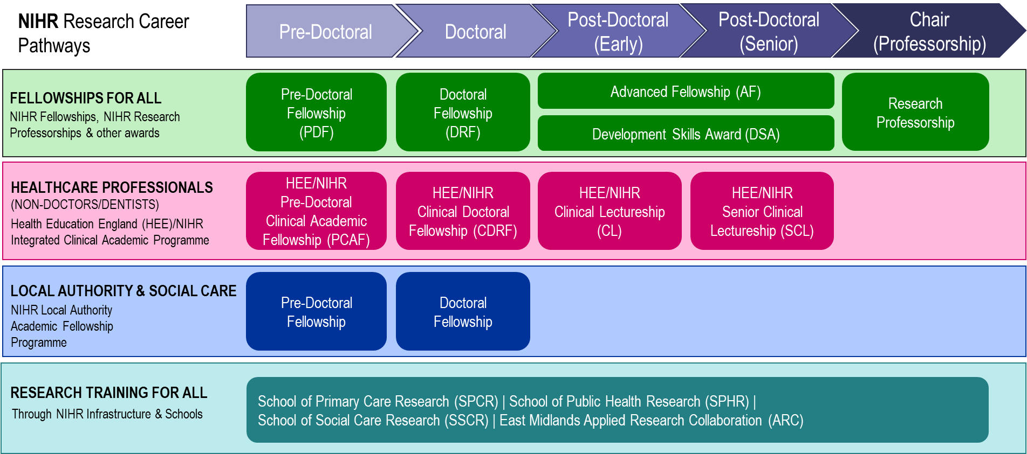
NIHR fellowship programme

Slide 41
Support available from the RDS for applicants
Dr Rachel Evley
Qualitative Adviser RDS East Midlands

Slide 42
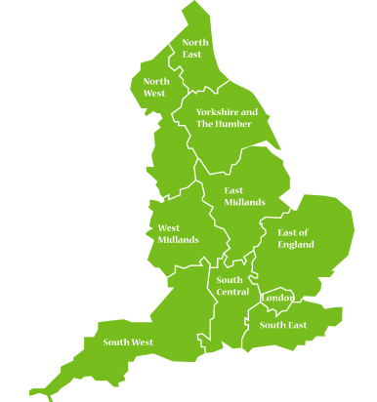
NIHR Research Design Service
The Research Design Service was established in 2008.
There are 10 RDS regions.
RDSs support researchers applying for NATIONAL peer-reviewed funding schemes for health and social care research
National Institute for Health Research (our priority)
Research Councils - UKRI
National Charities e.g. Wellcome Trust, CRUK

Slide 43
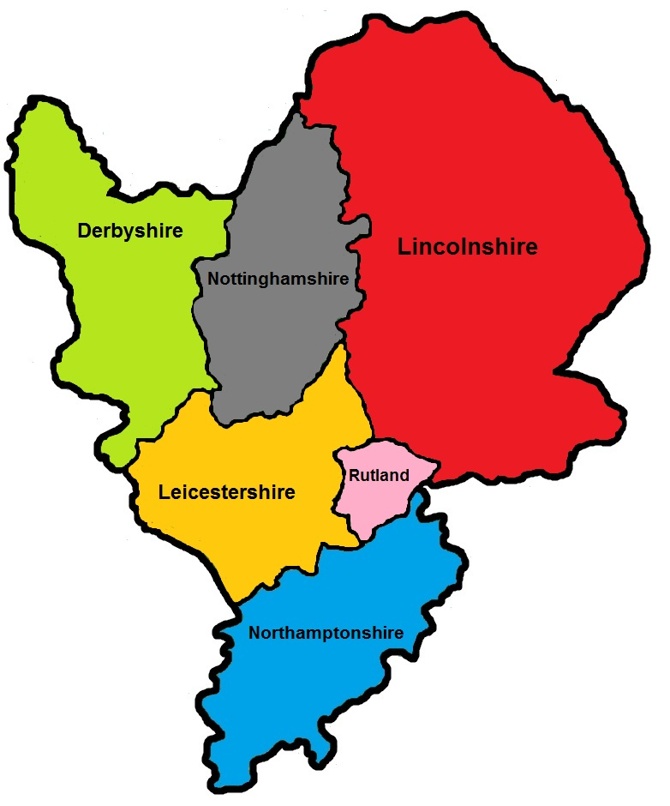
RDS East Midlands
Our bases are in Leicester and Nottingham but we cover the whole of the East Midlands Region
Our Team includes:
Medical statisticians
Health economists
Epidemiologists
Behavioural scientists
Qualitative methodologists
Social scientists
Public involvement experts
Information specialists

Slide 44
How to contact us
Contact us through our website or by email
www.rds-eastmidlands.nihr.ac.uk
We ask researchers to provide a little information by completing a form on our website
who they are
the project
whether they have a funder in mind
the advice they need
We also ask people to read our working with the RDS and confidentiality agreement

Slide 45
How the RDS can help
Evidence
Research literature
Current studies
Need for this research
Design
Team
Research design
Methodology
Grant writing skills
Critical Review
Appropriate expertise
Depth & Breadth
Commitment
Application
Remit
Priorities
Process
Deadlines
Contracting
Funding limits
Competitiveness
Funder
Impact
Potential benefits to:
NHS/Social Care
Patients and others
How will that potential be realised
Involvement
Meaningful public involvement
throughout all stages of the application including developing the application itself

Slide 46
We can also
Signpost to other useful services (e.g. CRN, CTUs, R&D Offices, etc)
Support public involvement (some funding may be available)
Navigate application forms and processes
Offer multidisciplinary advice panels (MAPs)
Review application drafts – ongoing or at our monthly review panel
Practice fellowship interviews
Interpret feedback from panels (whether successful or unsuccessful)

Slide 47
Useful links
RDS Resources
RDS South Central Essential Guide to Grant Applications (YouTube channel) - https://bit.ly/3tlAjis
RDS London Resources - https://www.rds-london.nihr.ac.uk/resources/
RDS Blog - https://www.rdsblog.org.uk/
NIHR Resources
NIHR School for Social Care Research - https://www.sscr.nihr.ac.uk/
NIHR School for Primary Care Research - https://www.spcr.nihr.ac.uk/
NIHR School for Public Health Research - https://sphr.nihr.ac.uk/
NIHR Academy YouTube Channel - https://bit.ly/3JtSHLK
PPI Resources - https://bit.ly/3EDWSll
Schedule of Events Cost Attribution Template (SoECAT) - https://bit.ly/3pMxIfY
East Midlands Clinical Research Network (CRN) - supportmystudyeastmidlands@nihr.ac.uk

Slide 48
East Midlands RDS contact details
rds.em@nihr.ac.uk
www.rds-eastmidlands.nihr.ac.uk
Follow us @NIHR_RDSEM

